Slide 1




User Models, Metrics and Measures of Search: A Tutorial on the CWL Evaluation Framework ACM CHIIR UMMMS 2021
by
Leif Azzopardi, Alistair Moffat, Paul Thomas and Guido Zuccon

Slide 2
Section Three: C/W/L extensions and open research
Presenter: Paul Thomas

Slide 3
This section
Web search ain’t like that: measuring a modern SERP
Metric evaluation: how do we know it’s any good?
Directions: how far can we push this thing?

Slide 4
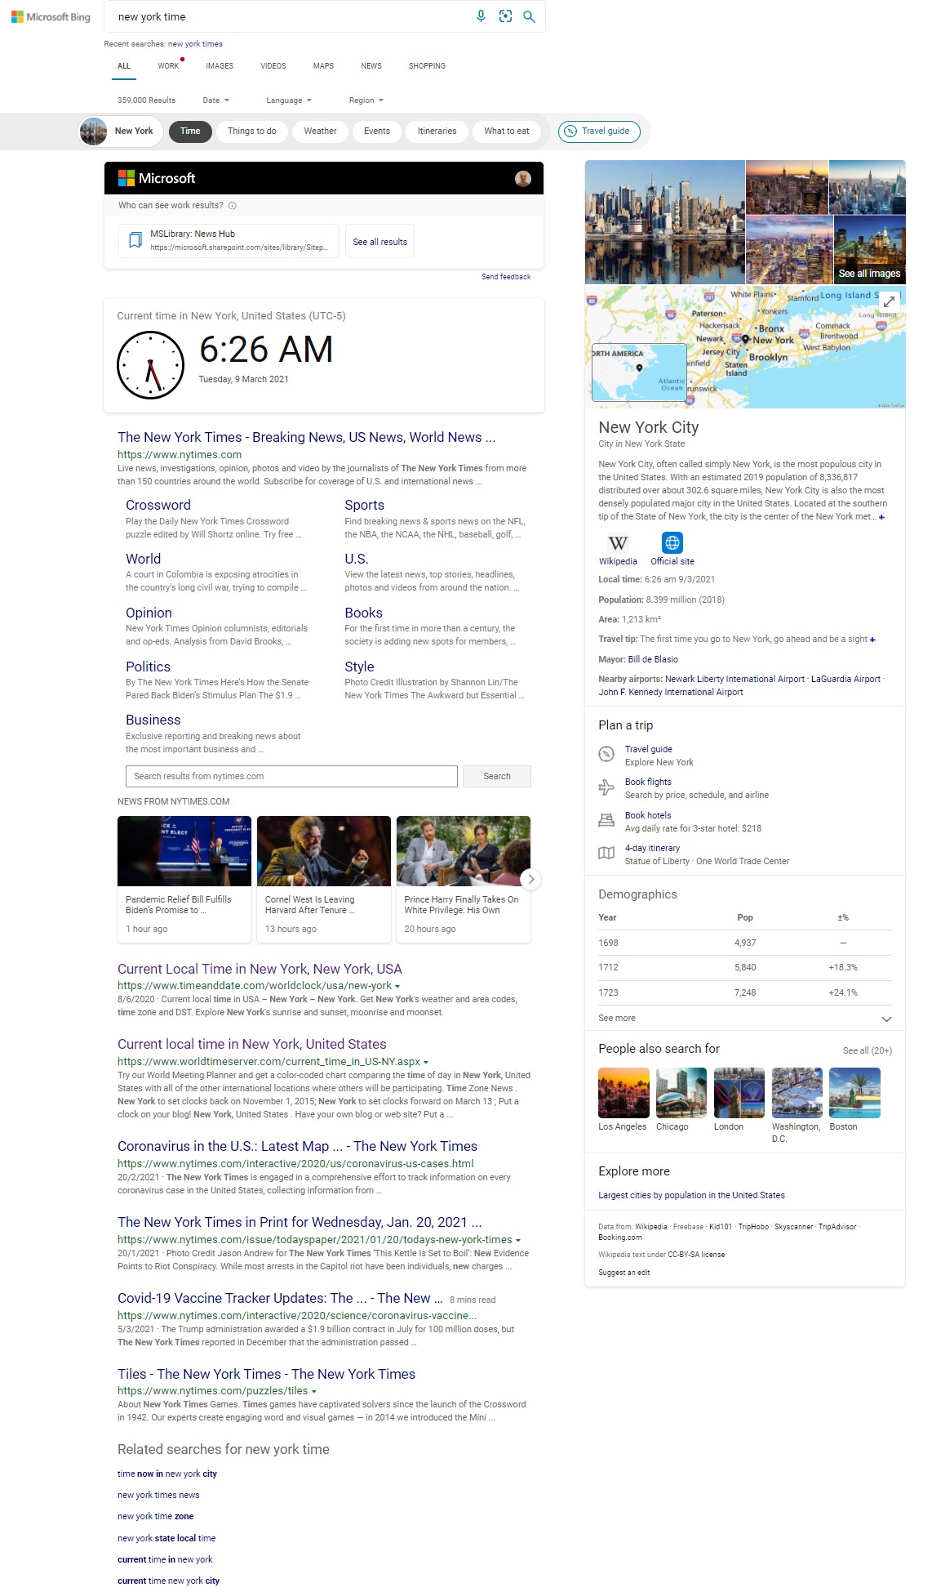
Notes:
So we have seen how a C fn is === to a model of how a SERP is read
Here’s a SERP
Q – how would we evaluate this?

Slide 5
Web search ain’t like that
Notes:
To cover:
Gain from snippets
Heterogeneity of results
Cost sensitive metrics: IFT (compared to BPM and others too)
**Is this covered earlier? Not in the overview doc anywhere**
It’s not all single shot – sessions (AM paper)

Slide 6
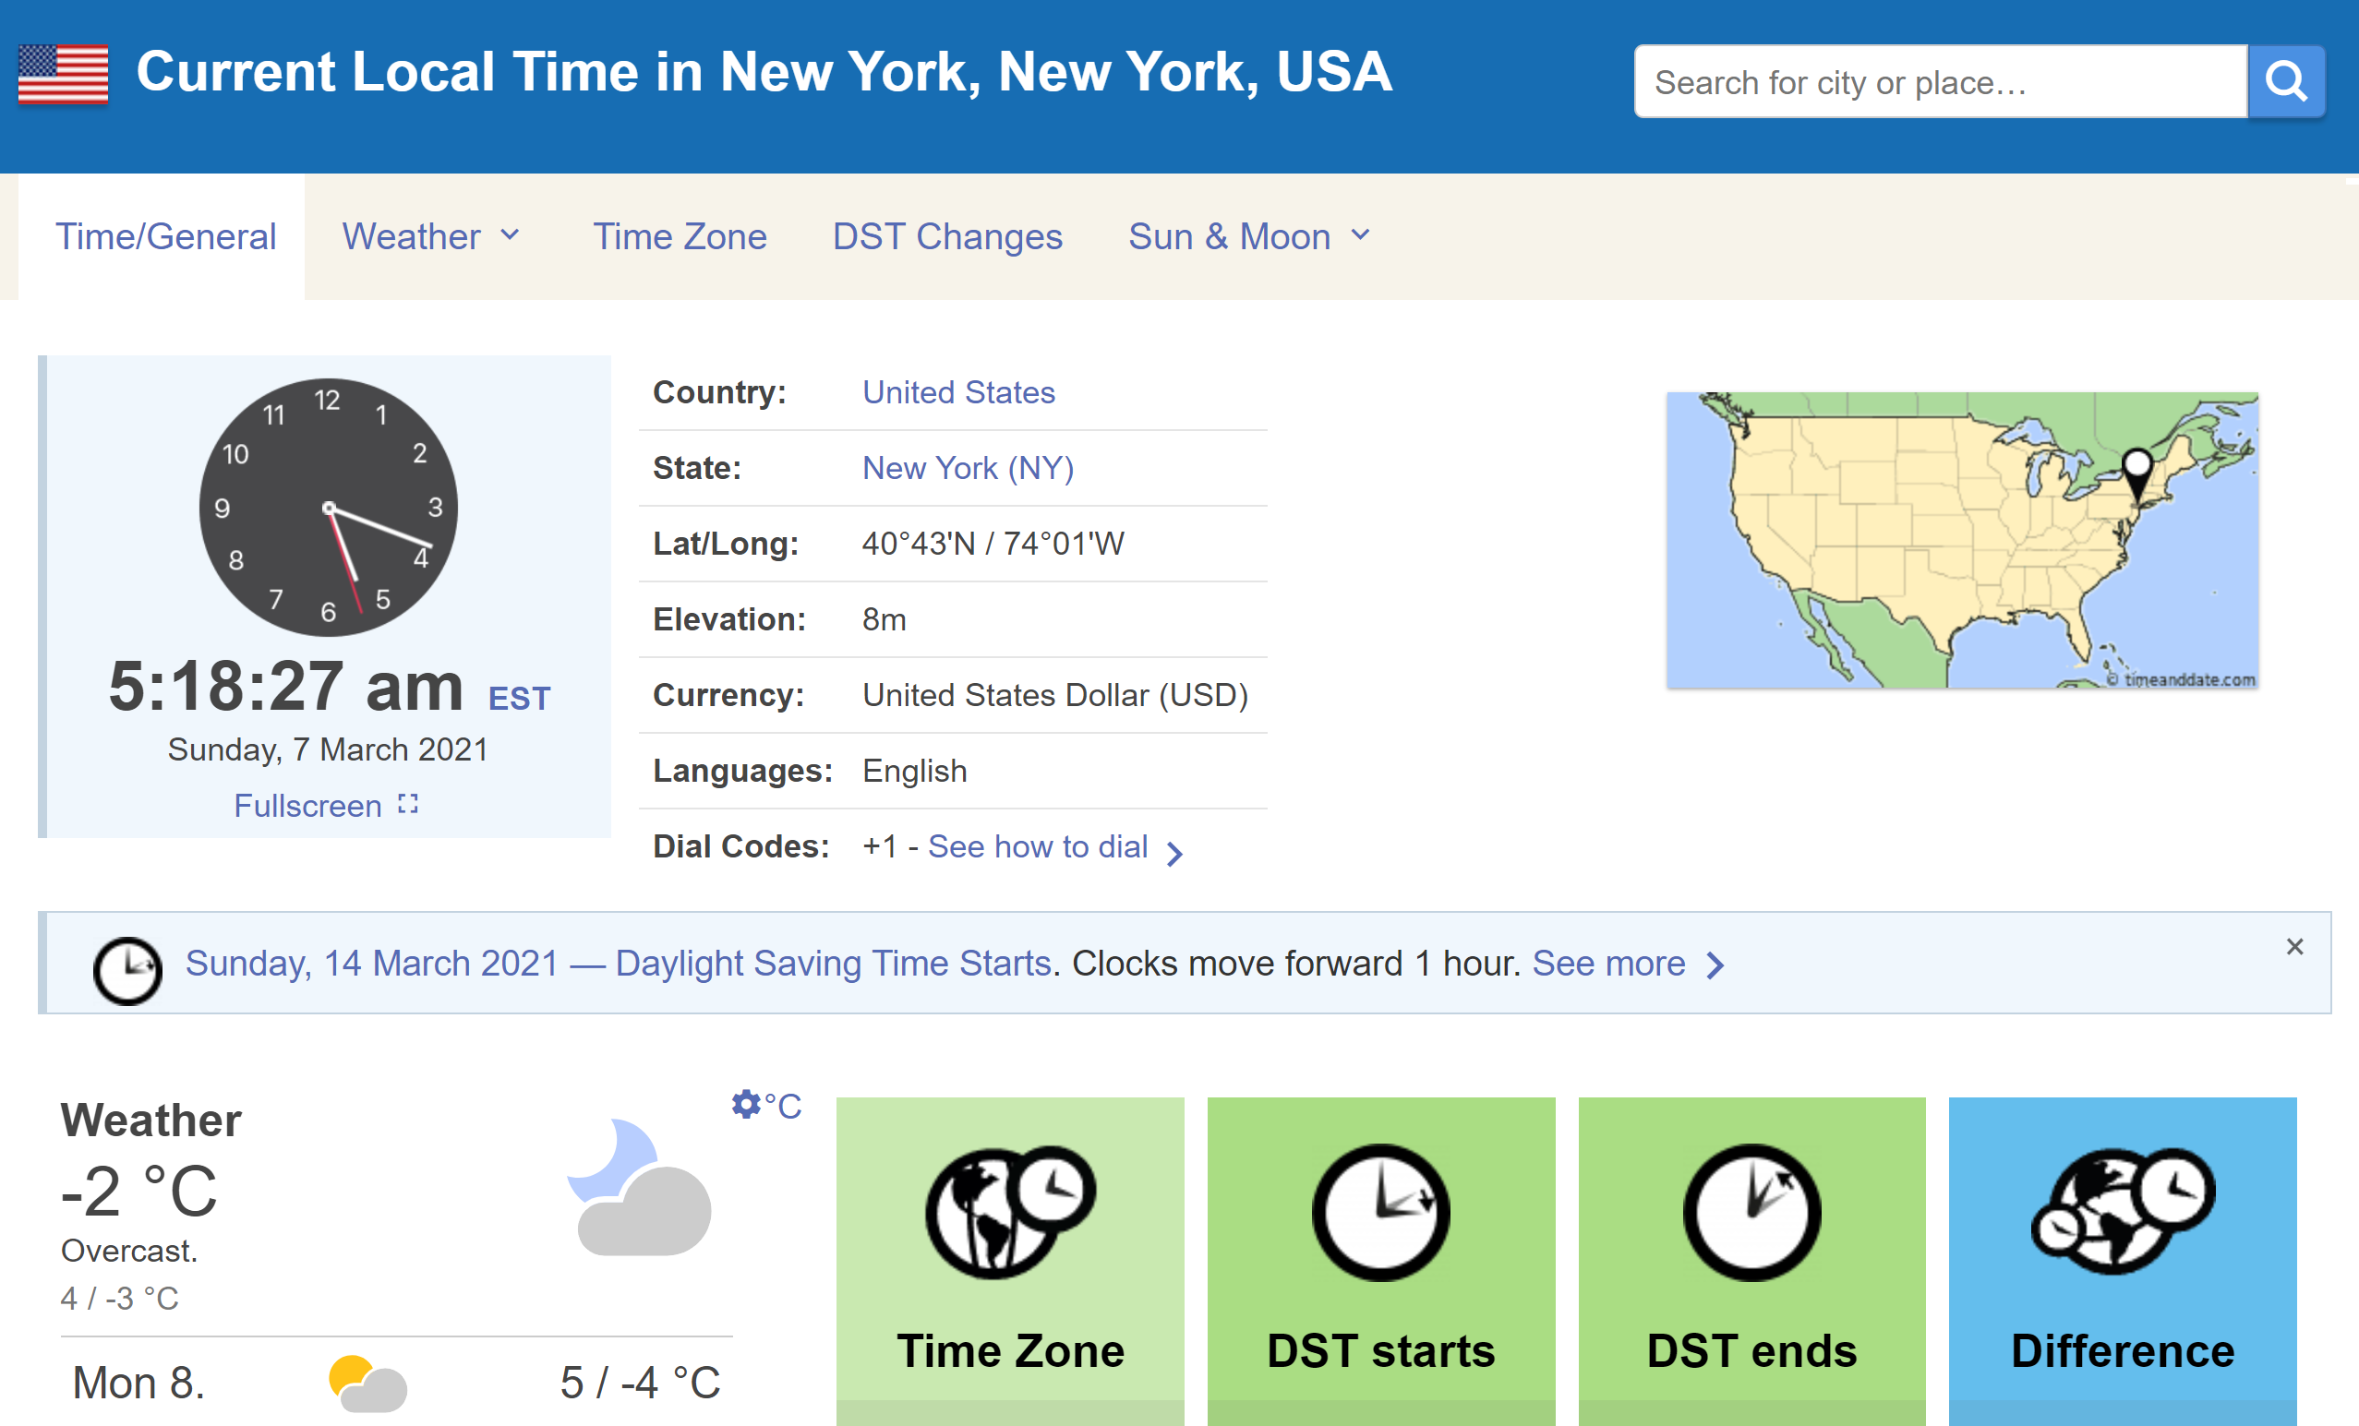
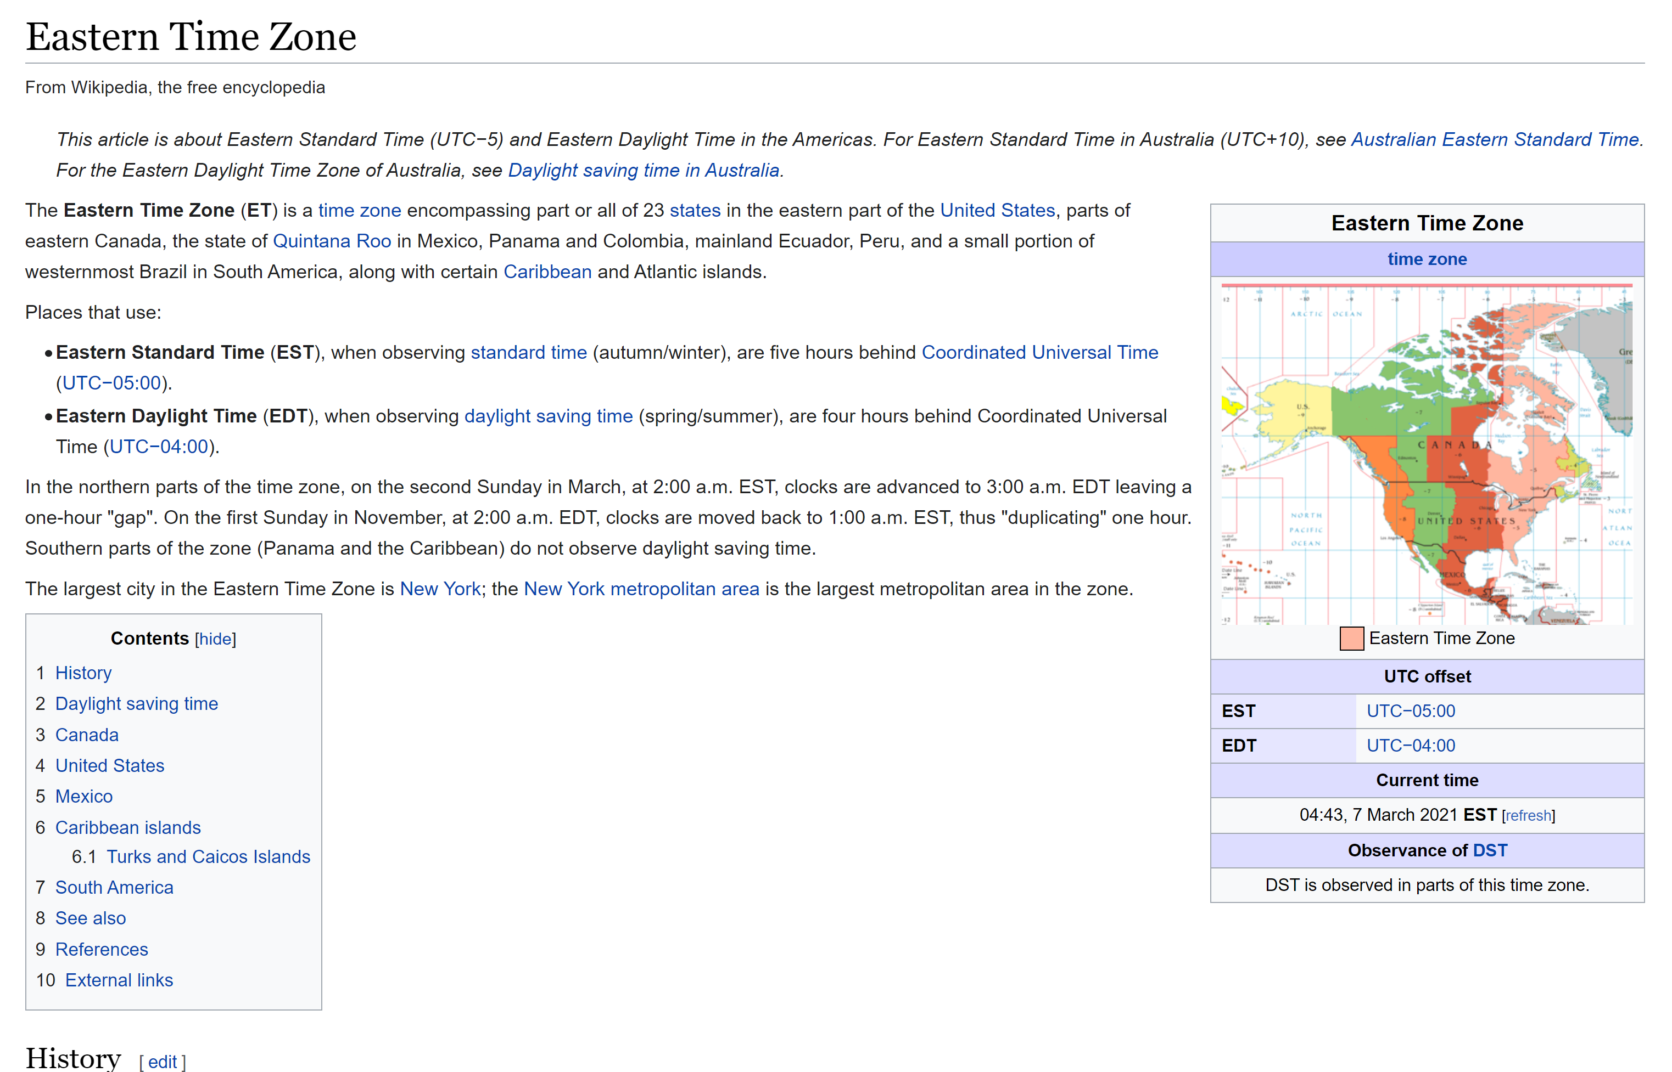
Different results
Notes:
Different results are different, even if they convey the same information. Here there’re two pages giving the timezone for NYC, but they provide that information in very different ways. Which is easier to read? What does that mean?
Some metrics take this into account e.g. TBG (Smucker&Clarke) adjusts for words on the page; but there’s clearly more to it than just that

Slide 7
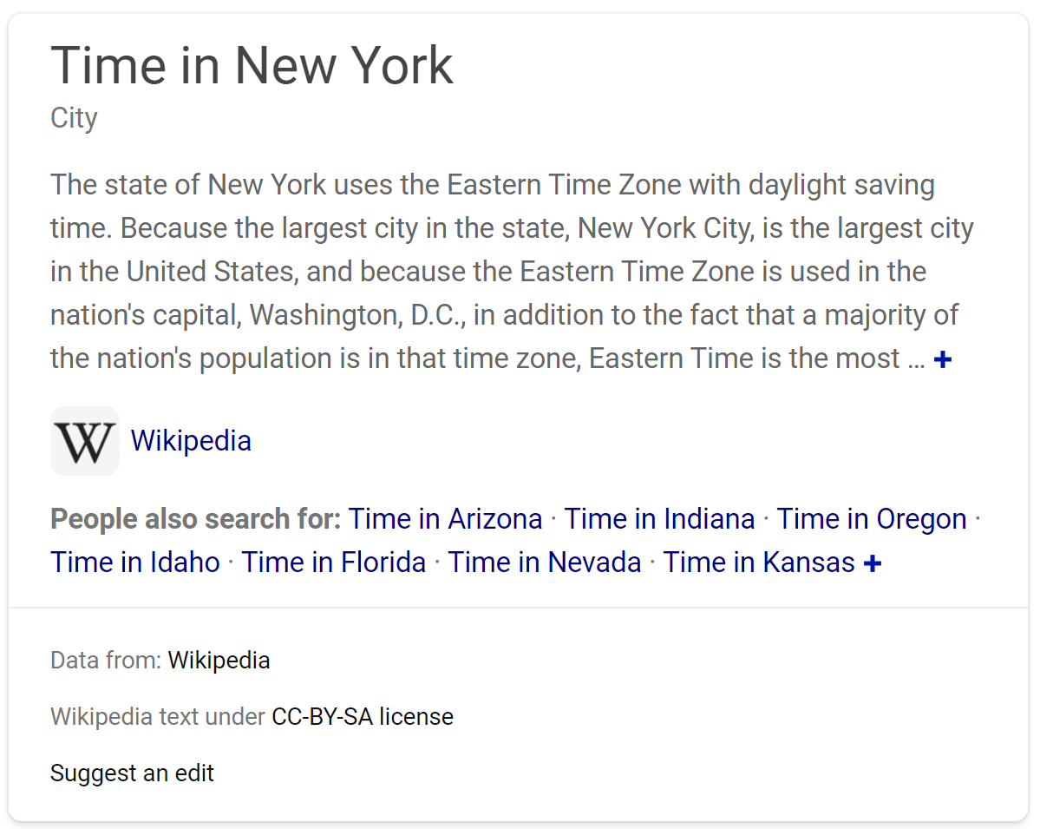
Gain from snippets
Notes:
Ok but sometimes there isn’t even a need to click – there is useful info in the snippet(/caption/card) itself
Here we have the timezone, and the source, we’re done
So is this a document? If so, now we have two very different sorts of documents with different interaction costs and only some of them are ever seen

Slide 8
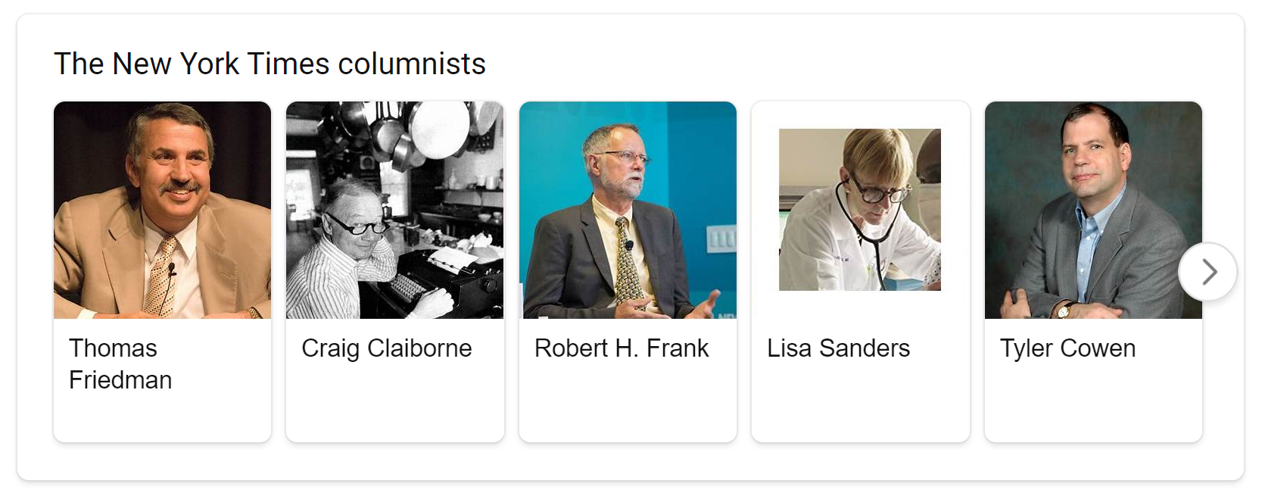
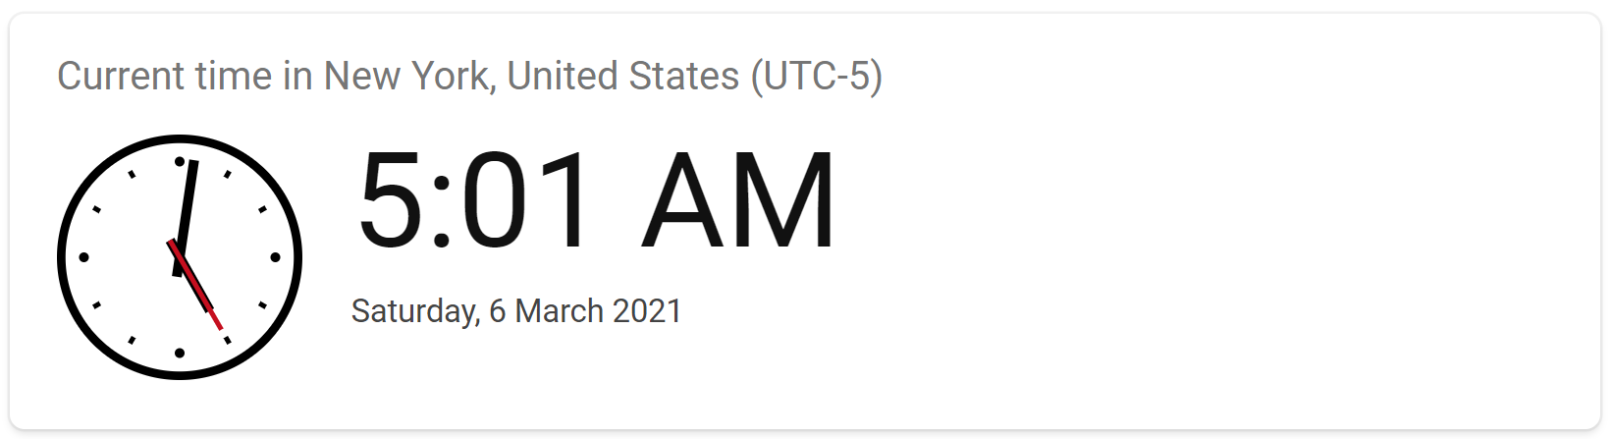
Heterogeneity
Notes:
This is just an instance of a yet more general issue: SERPs are highly heterogeneous. These are all very different things. Just seems wrong to say we’re reading a list of ten homogeneous things, we’re clearly not, and we need to understand what C should look like in these cases.
(Or if C even works still…)

Slide 9
Metric evaluation
Notes:
Another line of research, not new by any means (examples…)
But certainly productive
Even if we’re doing intensive fitting: Infinite Cs ➔ infinite metrics
How do we choose?
How do we know if it’s any good?
rhetoric

Slide 10
“
“
Notes:
Well maybe… but I’d like to point to some other things too.

Slide 11

Metric evaluation: Cost
Labelling takes real time and money.
Computation may also take real time and money.
Notes:
Won’t dwell
But metrics have real cost. Labelling results for example takes time, may take $
Computation is not typically significant but might be if we start computing many counterfactuals or needing to do lots of bootstraps, for example
Want to get more from time to time to mitigate overfitting, stay current
This isn’t unique to CWL models, although CWL may sometimes give a start on knowing how much to label by giving an easy way to compute residuals and an easy way to talk about reading depth (which gives us an upper bound on how much to label)

Slide 12

Metric evaluation: Sensitivity
Metrics are more useful the more sensitive they are to real changes.
Notes:
For example we know that people pay a lot more attention to rank 1 than to ranks 2-5 – so if you had to choose, P@1 is a better model of real reading behaviour than P@5
But it’s a rubbish metric for comparing two systems because it’s really hard to shift
Of course it has to be sensitive to real changes – e.g. the mean gain between ranks 100 and 199 can take many many values, lots of scope for movement in response to changes in a system, but so what?
There is a tension sometimes, sensitivity vs cost vs other things. That’s true of all these criteria.

Slide 13

Metric evaluation: Interpretability
Interpretability, debuggability, use for diagnostics are extremely important.
Can we do something with the result?
Notes:
This is really important, Need to remember why metrics – to help us build better.
Real people use these e.g. in Bing, 100s(?) of people working on ranking. Could have a model with exquisite fidelity, but an engineer needs to know why things got better or worse and then act on it. Model needs to be interpretable
Again in tension, e.g. R@lots is great for debugging (did I even find the right stuff at all?), easy to interpret, even if it’s low fidelity
AP is similar
Key Q: Can we explain it to someone? A “better” metric might not be better if it’s too hard to explain why it’s reading a certain way
Forward ref to LA’s demo in part 4

Slide 14

Metric evaluation: Face validity
Does the metric look like it should measure what we want it to measure?
Does it look effective?
Do we believe the user model?
Notes:
Essential!, but not itself adequate, people do lots of things and vary too many ways to be sure what’s going on
Does the metric look like it should measure what we want it to measure?
Does it look effective, for whatever we decide “effective” should mean?
Do we believe the user model?
Nice thing about CWL is this comes down to: do we believe C?
Real perk of CWL: you have to write down a C fn, you have to explicitly state what you’re saying people will do
e.g. do we believe the model (we are forced into) for AP? Seeing Alistair’s derivation – where you have to peer forward in time – makes it clear there’s something funny about that model
TO DO We had a paper somewhere on this ☺
Do we believe the value statements in the model?
So for CWL, do we believe the gains and costs?
Data driven? Need data! (point to DDM paper?)

Slide 15

Metric evaluation: External validity
How well do our conclusions carry over to another setting?
How much do we learn about the “real world”, not just the instrument itself?
Notes:
How well would a conclusion based on this metric carry over to another setting?
So, how much does this tell us about the real world and not just the instrumentation itself?

Slide 16
Metric evaluation: External validity
Correspondence with…
Other metrics
Short-term behaviours
Side-by-side/setwise pref’s
Long-term behaviours
Business goals
Notes:
Been done in a bunch of ways
Correspondence with other metrics – but yawn…
Correspondence with short-term behaviours
Side-by-side preferences – relatively expensive as can’t reuse judgements
Long-term behaviours e.g. revisits – very hard to see any effects
Business goals revenue/ethics
Hierarchy less valid but more sensitive, agile, …
Behaviours: C/W/L explicitly models this so it’s easy to check! Nice one.
Gaze tracking
Click patterns

Slide 17
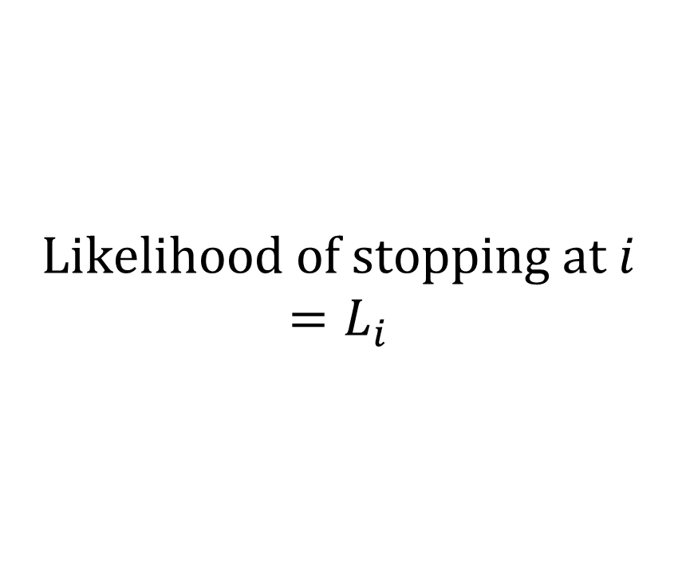
Reflecting observable behaviour: 1
Stopping
Accumulated utility
Accumulated cost
$$\text{Likelihood} \text{of} \text{stopping} \text{at} i$$
$$=L_{i}$$

Slide 18
Model / measure | Mean likelihood
P@1 | 0.49
P@5 | 0.00
P@10 | 0.00
SDCG@1 | 0.49
SDCG@5 | 0.33
SDCG@10 | 0.33
RR | 0.36
RBP, φ=0.1 | 0.44
RBP, φ=0.7 | 0.16
INST, T=1 | 0.34
INST, T=2 | 0.21
IFT | 0.76
Notes:
Both tuned and commonly used
Shallow – more likely
But not always best, e.g. P@1 is .49 so 1/2 the time people stop lower

Slide 19
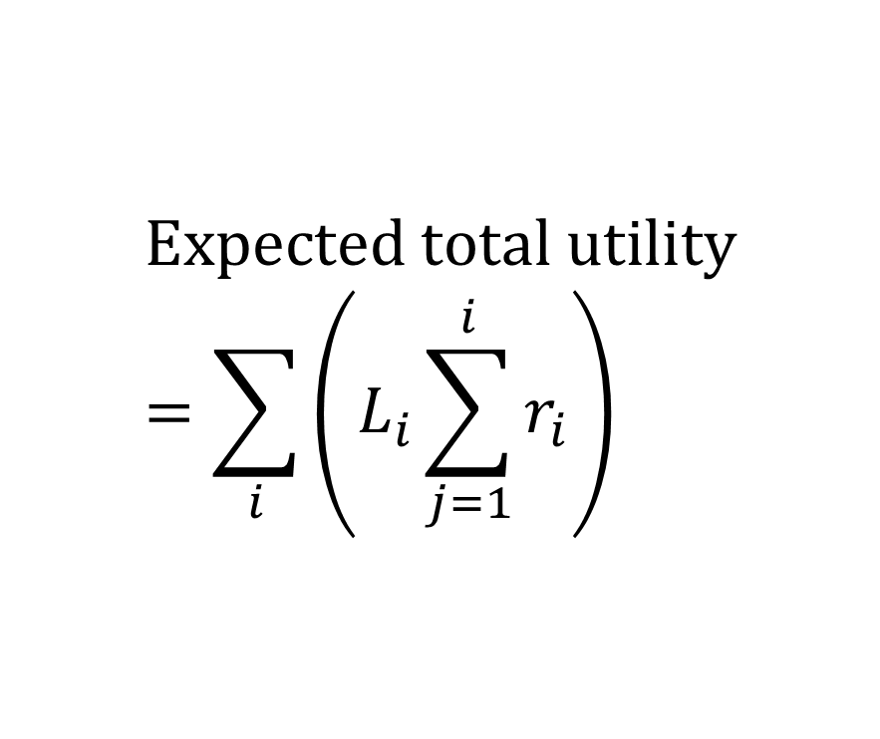
Reflecting observable behaviour: 2
Stopping
Accumulated utility
Accumulated cost
$$\text{Expected} \text{total} \text{utility}=\sum_{i}{\left(L_{i}\sum_{j=1}^{i}{r_{i}}\right)}$$
Notes:
Look at …… impressions, look at clicked results and relevance labels for these, add up over a session
Recall from Alistair’s section that it’s easy to predict the total utility over a session
So we can report the difference

Slide 20
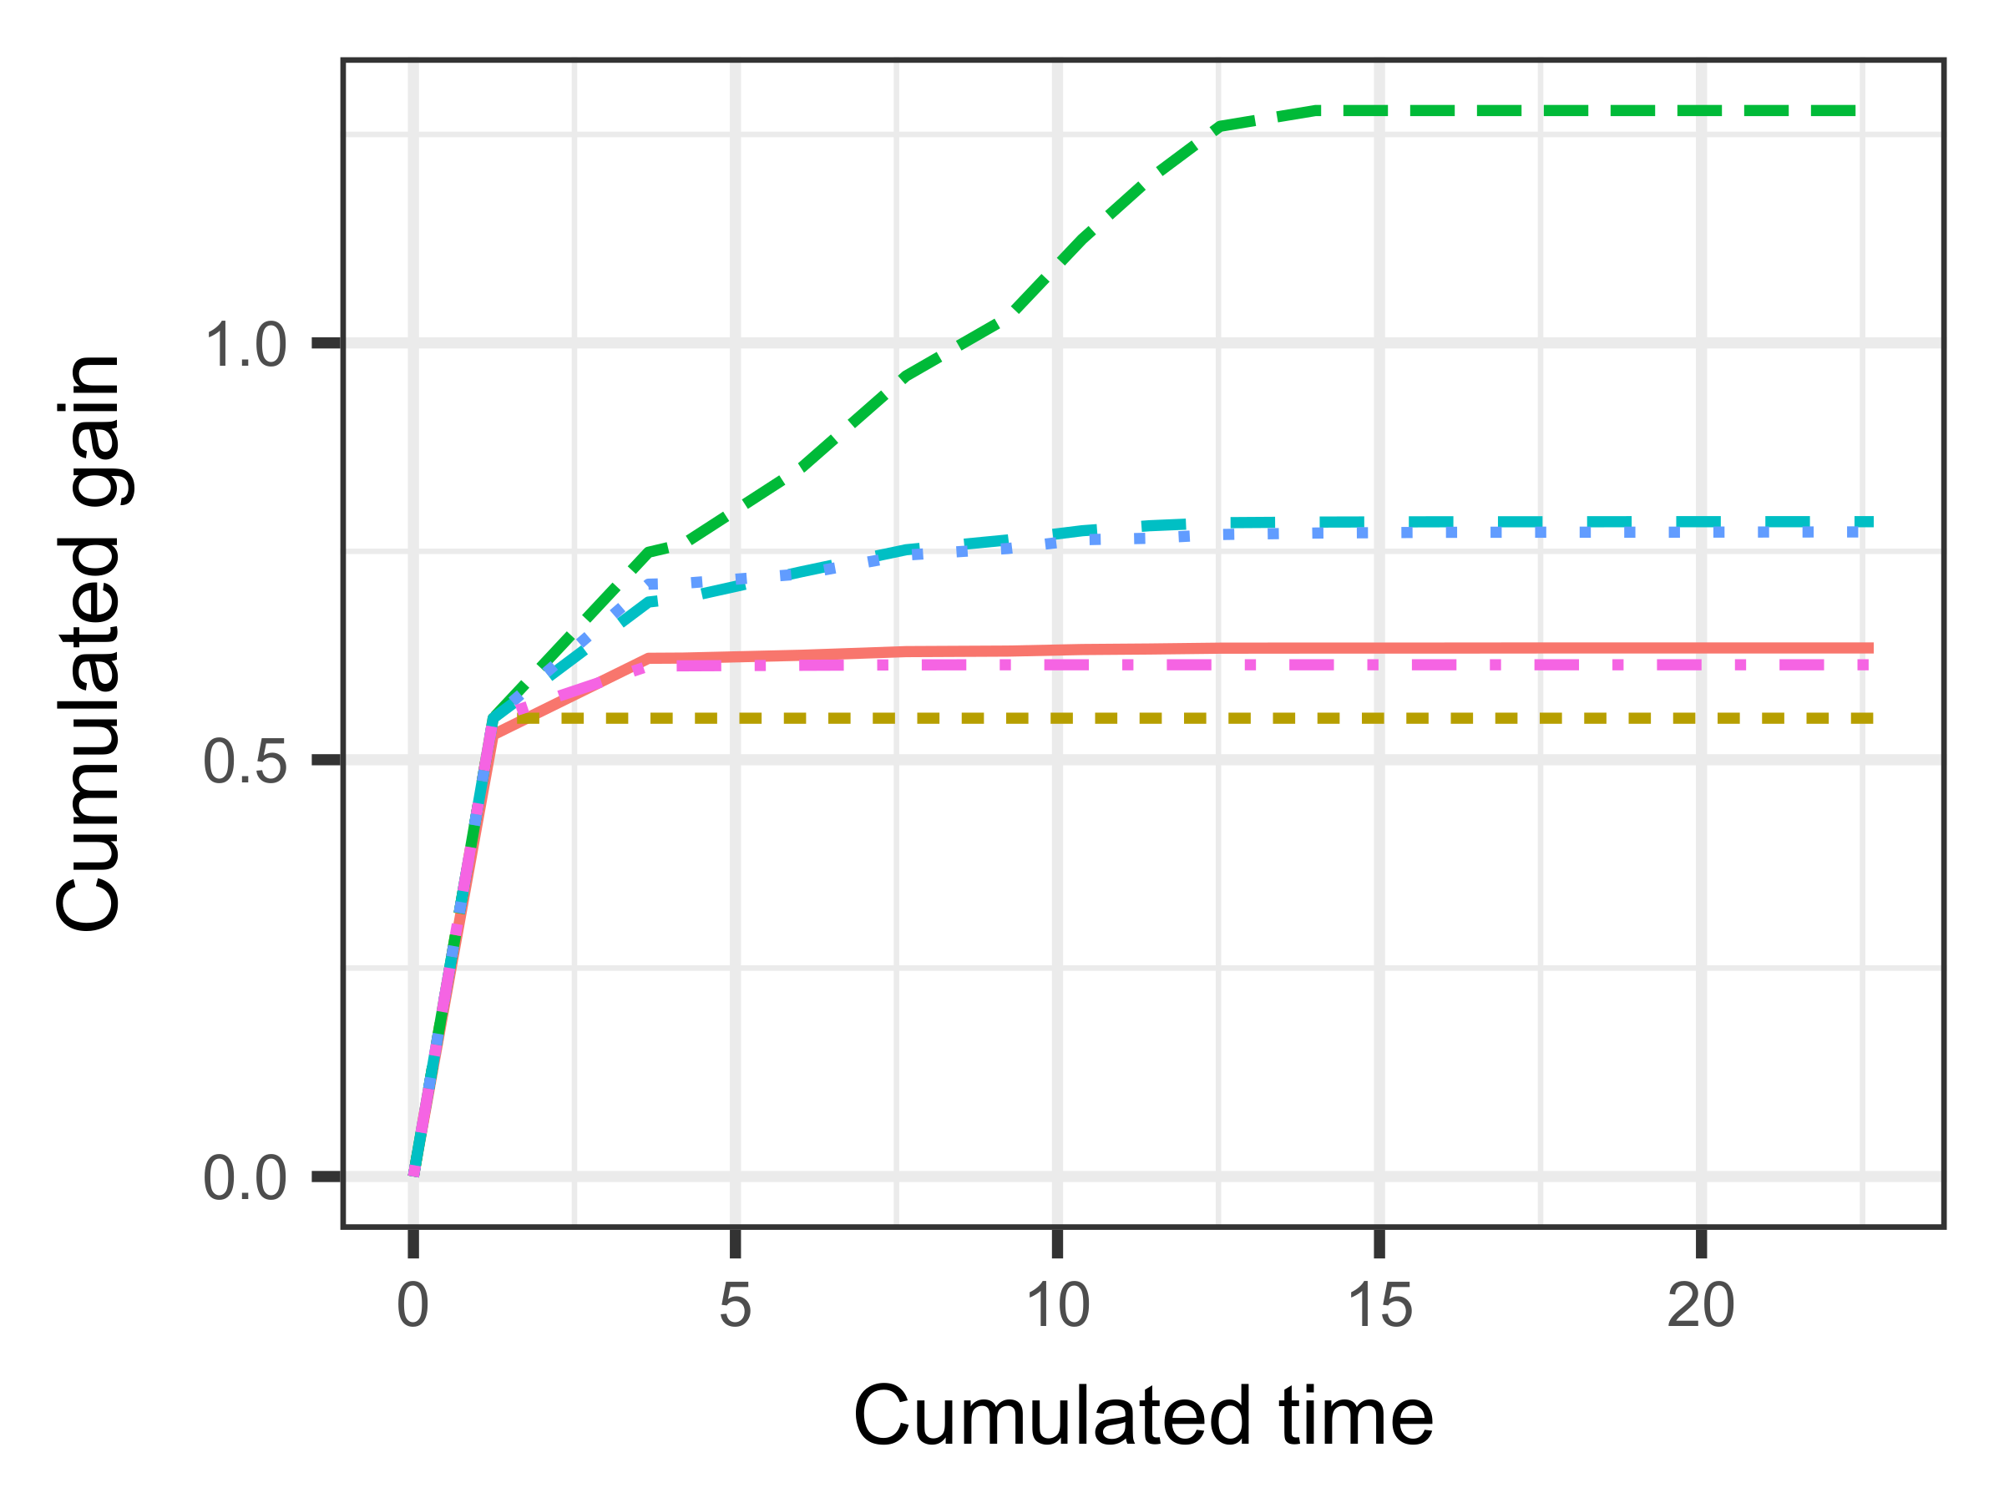
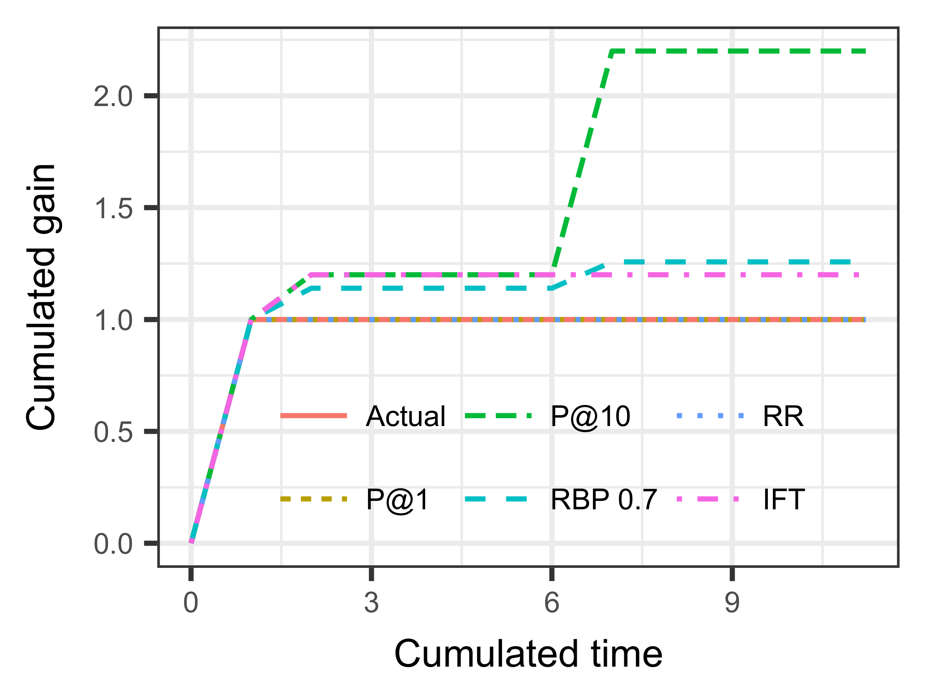


P@10 way too high
RBP, RR both too high
IFT does well
P@1 a bit low
Average over 5000 impressions
Azzopardi et al., SIGIR’18

Slide 21
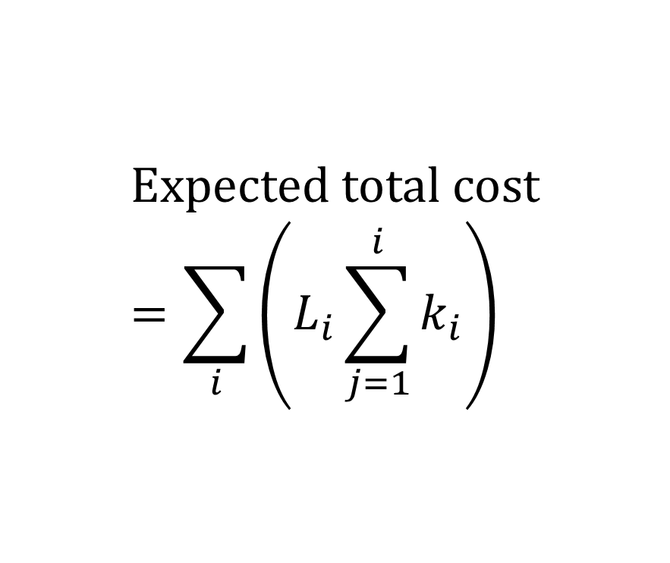
Reflecting observable behaviour: 3
Stopping
Accumulated utility
Accumulated cost
$$\text{Expected} \text{total} \text{cost}=\sum_{i}{\left(L_{i}\sum_{j=1}^{i}{k_{i}}\right)}$$

Slide 22
Directions

Slide 23
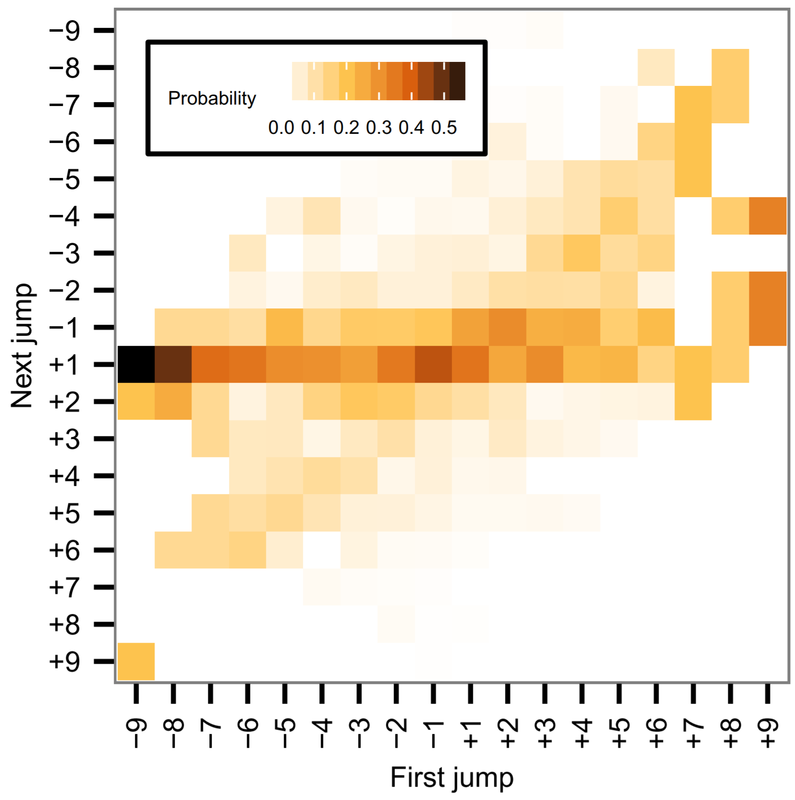
Top-down reading??
Thomas et al., AIRS’13
Notes:
Alistair has shown this. Note the mass on next+first= +1, i.e. people dart about but tend to read downward. Still they’re clearly doing something and there is a big mass at net-moving-backwards. So this is an oversimplification.

Slide 24
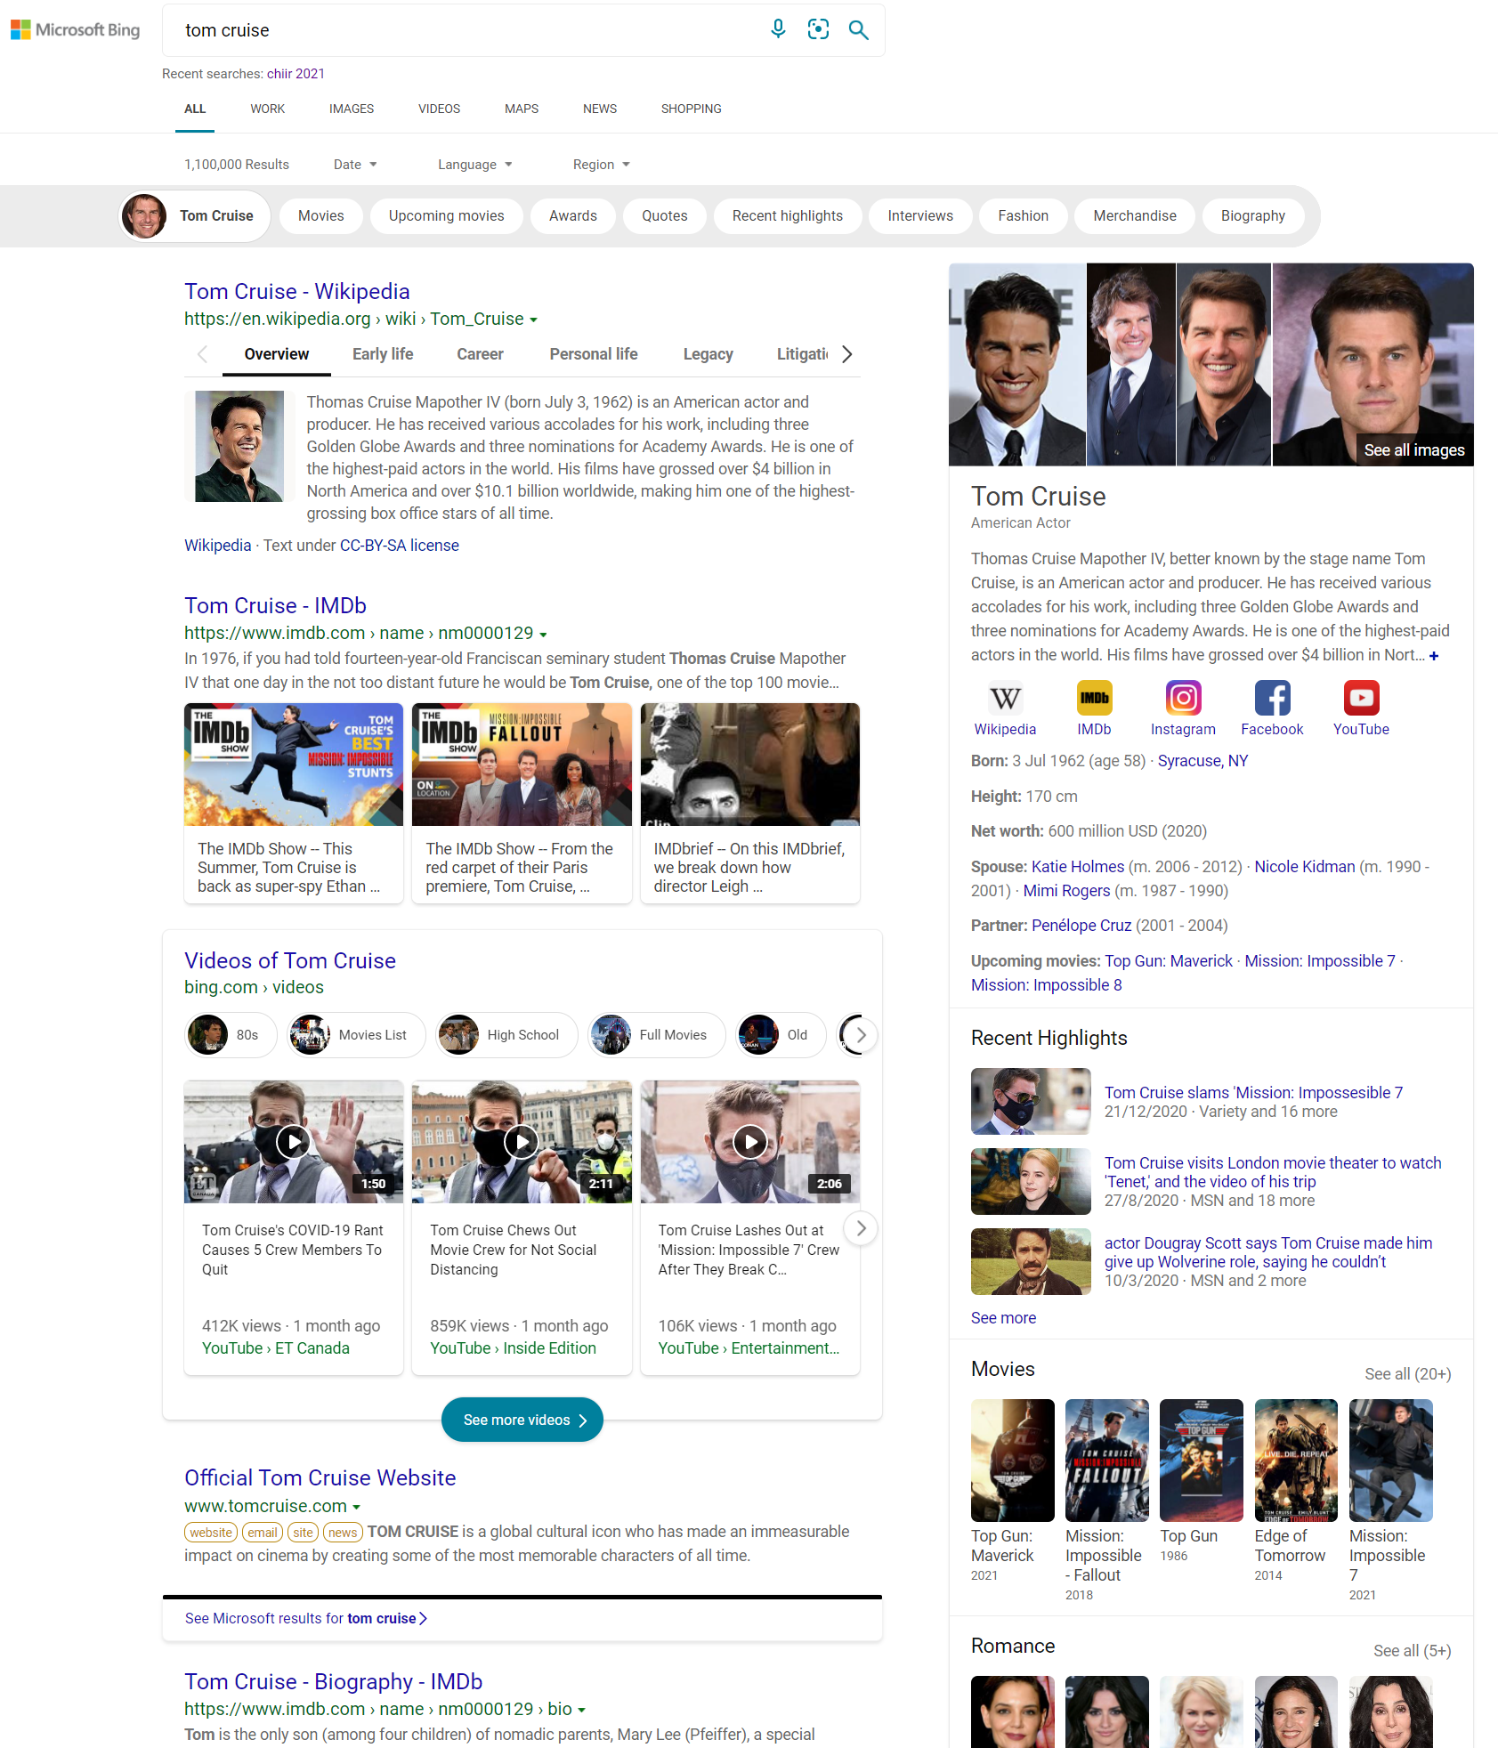
Top-down reading??
Notes:
But it really breaks down here! We have tried to linearise this by looking at the mean arrival time; and decided that e.g. one mainline, a couple of the right sidebar, then a couple down the mainline, etc, is a fair first approximation. But maybe it’s time to do this more comprehensively.

Slide 25
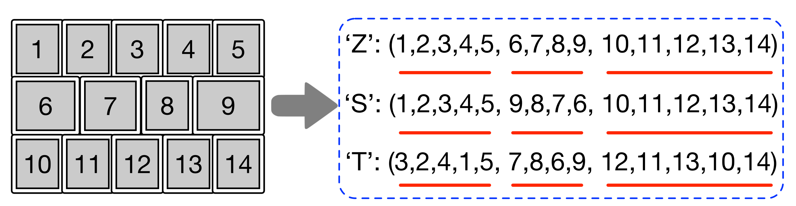
Top-down reading???
Zhang et al., SIGIR’18
Notes:
Zhang et al looking at image search – typically 2d these days – wanted to use CWL-able metrics like RBP, DCG. Had noticed people don’t read TL to BR in an image grid. Three other reading models.

Slide 26














Top-down reading???
Notes:
But of course there’s more to it than that – I bet you keep looking at the kitten. We know that people are attracted to bolding in captions, and to images, for example. How can we model these effects? What’s salient? What can we draw from the physc. literature?

Slide 27
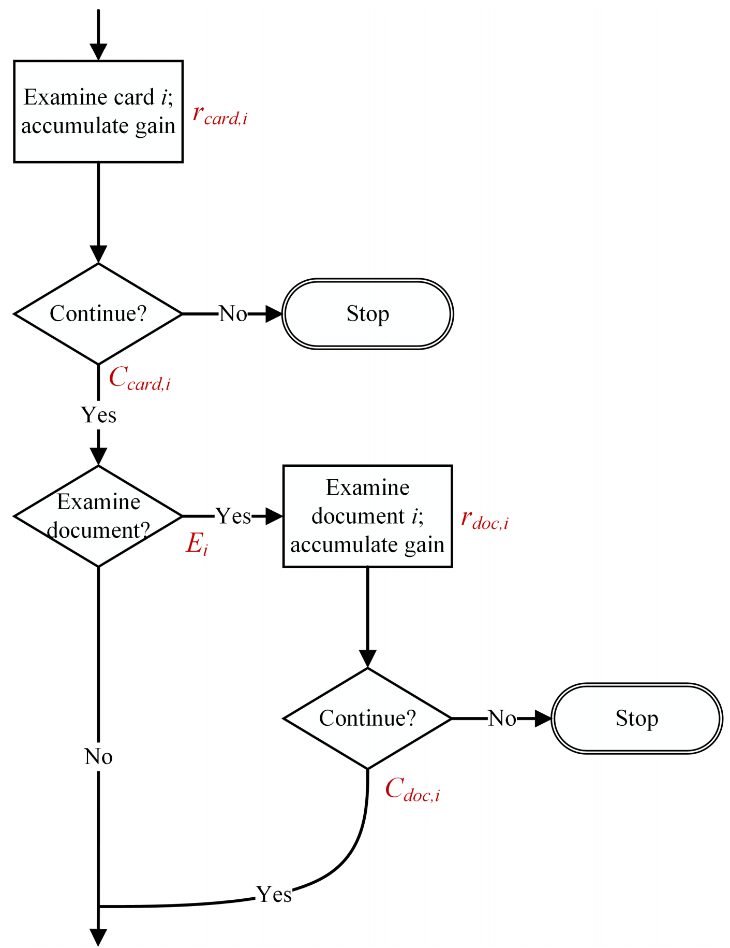
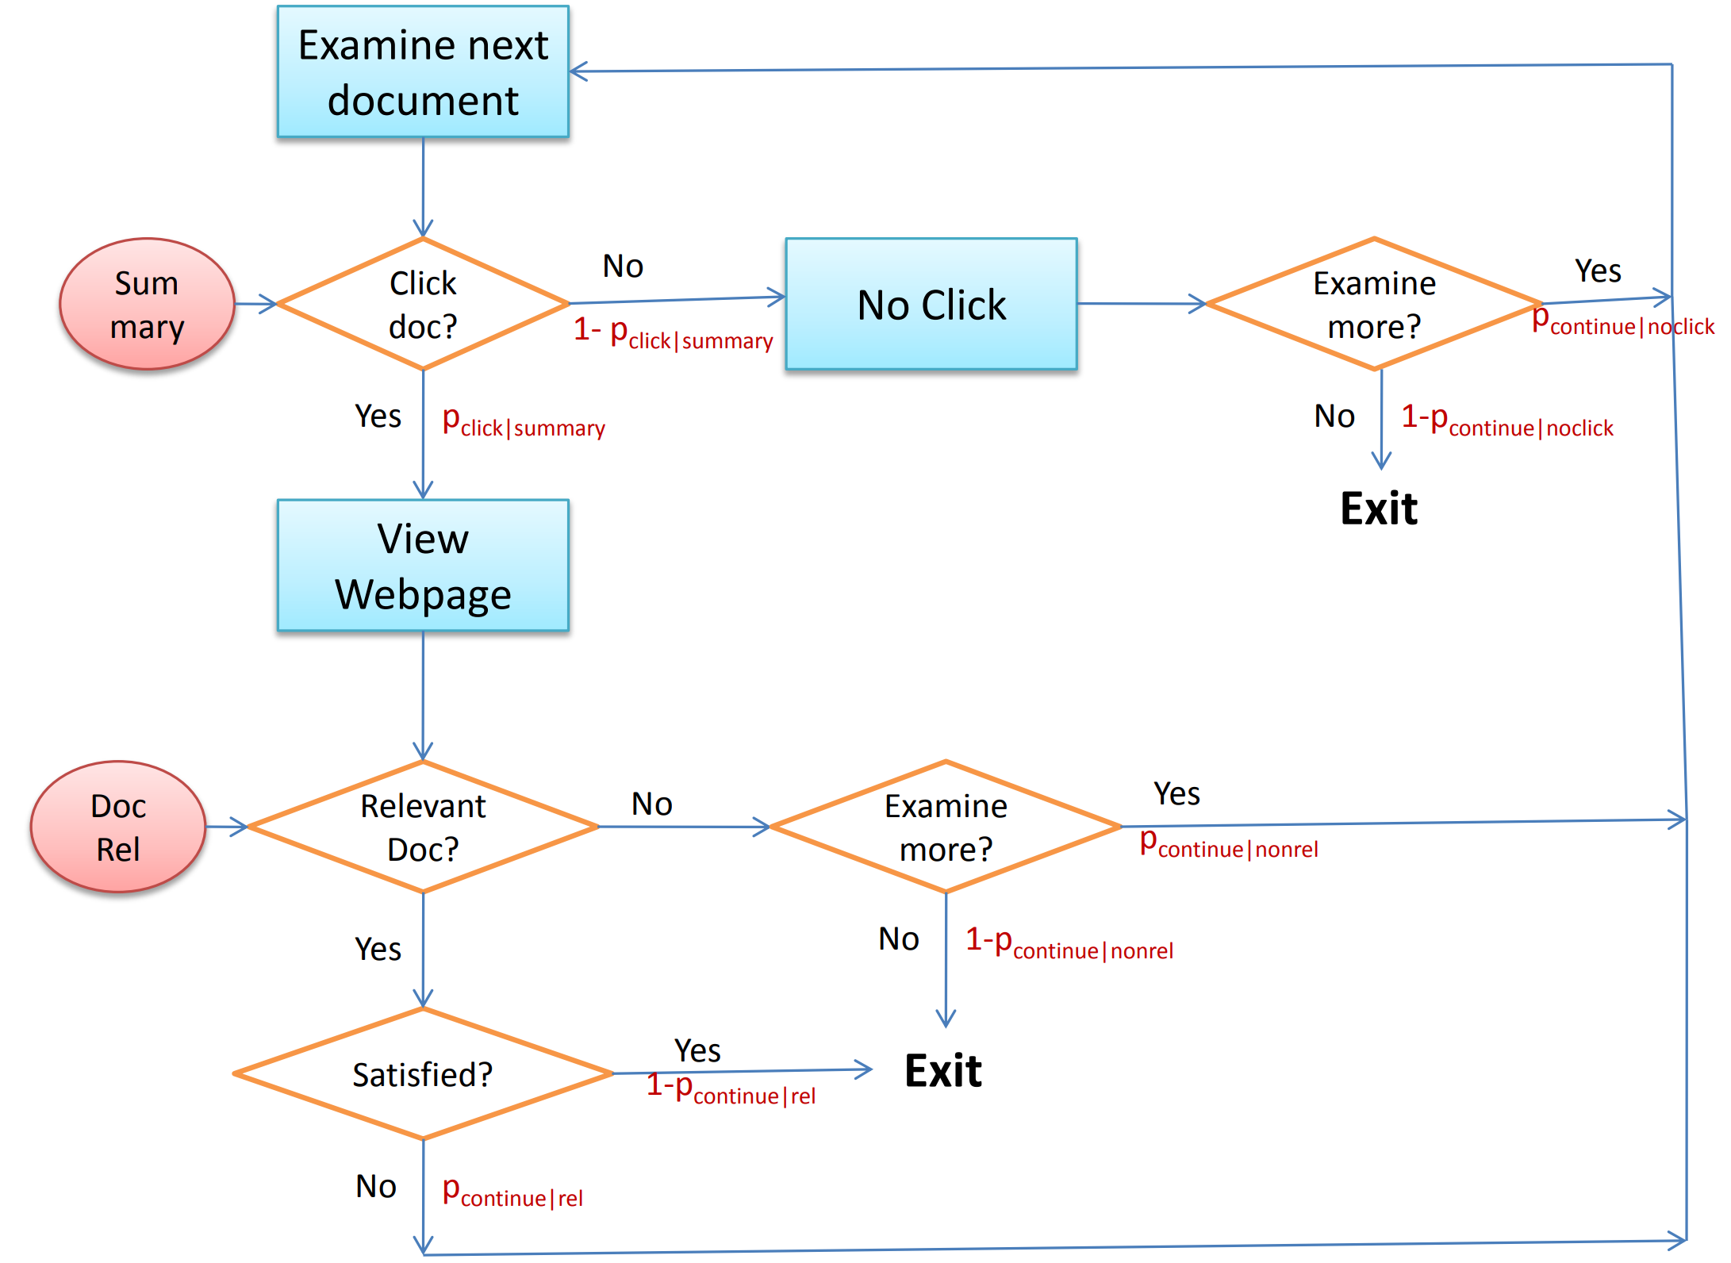
Gain from cards
Thomas et al., ADCS 2018
Yilmaz and Craswell, CIKM 2010
Notes:
Attempted to deal with this by having a branch in the model – read a doc or not – and combining paths to get C and gain in expectation over both paths. But that’s sort of clunky. E was based on attractiveness of card
Not a new idea – see e.g. Yilmaz/Craswell EBU metric, which conditioned “click doc?” on relevance – but no room here for gain
See also e.g. work by DMax

Slide 28
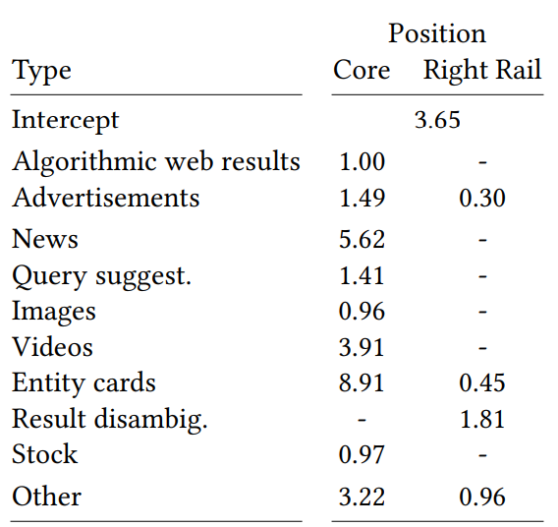
Heterogeneity
Azzopardi et al., SIGIR’18
Notes:
So what can we do when they’re all different types? We can enumerate the types, and fit to the data we have…
…but this scales badly (e.g. can’t do a new type without first shipping it), needs lots of data, isn’t constructive
Would be great to have a more general theory here

Slide 29
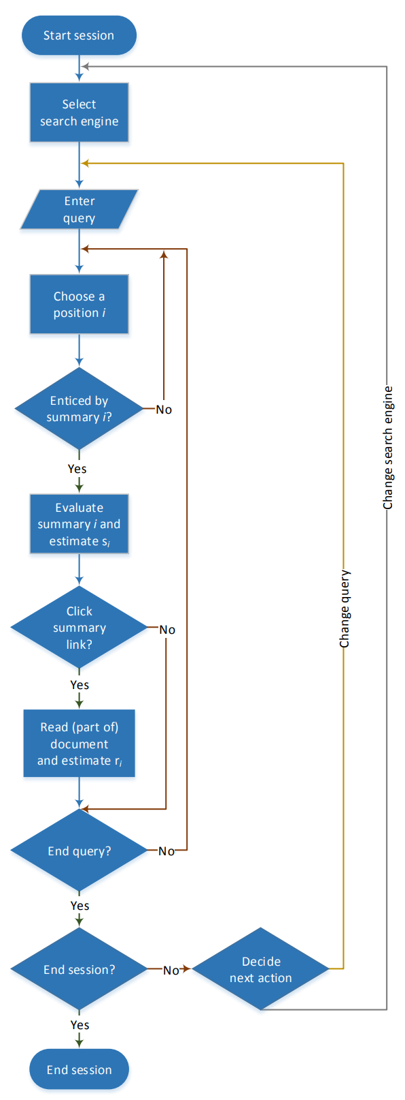
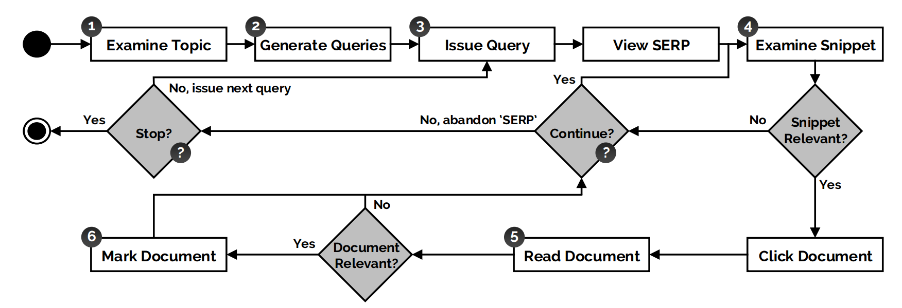
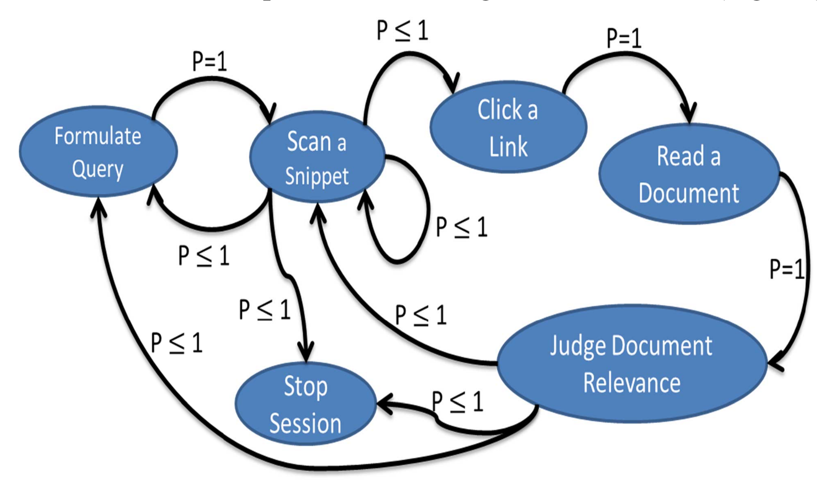
Sessions
Thomas et al., IIiX 2014
Maxwell et al., CIKM 2015
Baskaya et al., CIKM 2013
Notes:
We don’t always consume a single SERP
Session-based DCG calculates DCG for each query, then applies a decreasing weight to these per-query scores.
Suggests a simple extension, re-invented or at least refined several times, where we wrap the C function in another C function
But can do more e.g. Jiang/Allan show that worst-performing query, and last in session, are more predictive of overall impression. Liu ditto. Consistent with peak-end theory, which is well known to marketers, but does now mean that W is not monotonically decreasing. Oh dear!

Slide 30
Other directions
Conversational interactions
CWL during an interaction
Streaming documents
Recommendation
Notes:
And then super briefly some other topics
Conv – gains and costs

Slide 31
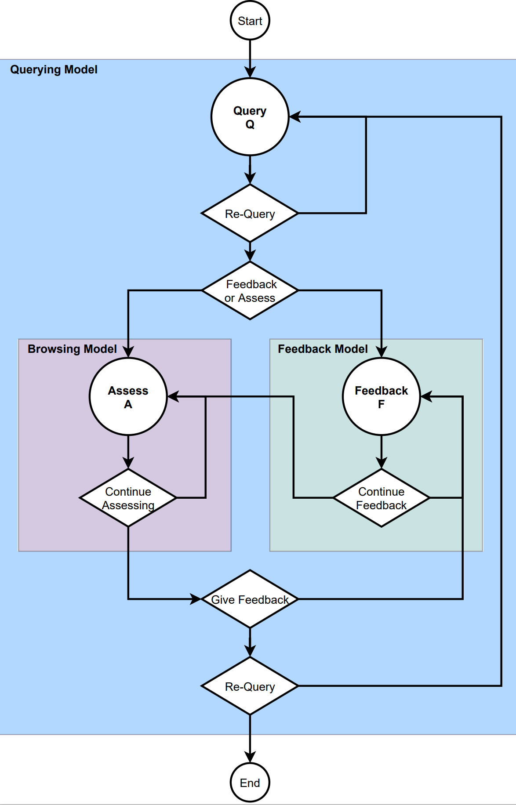
Other directions
Aliannejadi et al., unpublished

Slide 32
Other directions
Conversational interactions
CWL during an interaction
Streaming documents
Recommendation
Notes:
CWL during – expected value, choose amongst options, maybe don’t just rank by immediate gain
Streams – Twitter, routing – super different user model
Recommendation - ditto

Slide 33
Summary of section 3
Web search ain’t like that: measuring a modern SERP
Metric evaluation: how do we know it’s any good?
Directions: how far can we push this thing?

Slide 34
Designing and instantiating metrics

Slide 35
Units of measurement
ETC, ETU, EU-per-examination, etc
A response to Norbert?

Slide 36
Fitting parameters
Data-driven approaches
EBU, TBG, DDMs, other exemplars?

Slide 37
Paul needs to look at…
Paakkonen17validating
Maxwell18stopping
Zhang10click
Yilmaz/Craswell/etc empirically deriving p(stop|relevance) (EBU paper?)
Wicaksono/Moffat CIKM’18; WSDM’20(!!)
Tetsuya
Ben
Leif’s suggestions x3

Slide 38


Model / measure | MAE (utility)
P@1 | 0.32
P@5 | 0.47
P@10 | 0.65
SDCG@1 | 0.32
SDCG@5 | 0.26
SDCG@10 | 0.38
RR | 0.36
RBP, φ=0.1 | 0.32
RBP, φ=0.7 | 0.38
INST, T=1 | 0.34
INST, T=2 | 0.36
IFT | 0.16

Slide 39
Model / measure | MAE (cost)
P@1 | 0.91
P@5 | 4.31
P@10 | 7.73
SDCG@1 | 0.91
SDCG@5 | 3.10
SDCG@10 | 4.98
RR | 1.71
RBP, φ=0.1 | 1.03
RBP, φ=0.7 | 2.60
INST, T=1 | 1.44
INST, T=2 | 2.16
IFT | 0.63

